Slide 1


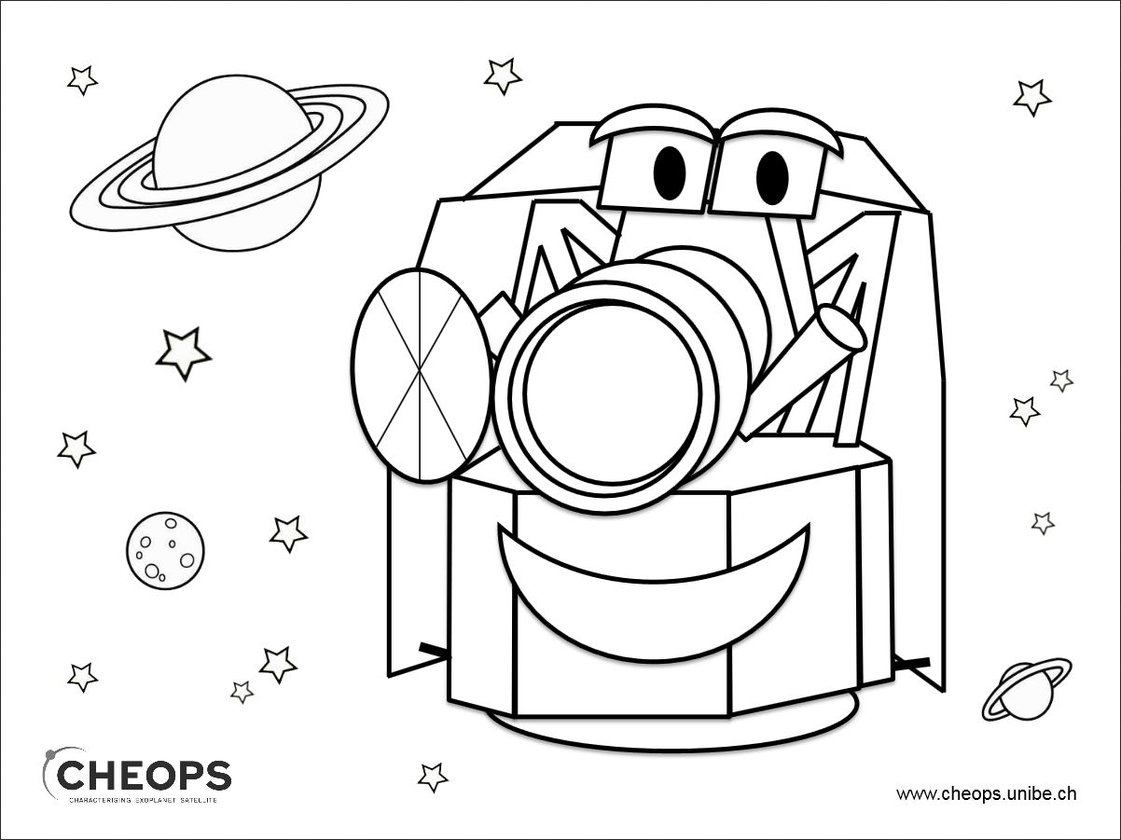






















CHEOPS Performance

Slide 2
Outline
CHEOPS 101: CCD, PSF, images and light curves
CHEOPS photometric precision
Hot pixels in the CCD: when should we care?
Instrument Systematics
Observing outside the nominal magnitude range
Overview of the Monitoring and Characterisation Programme

Slide 3
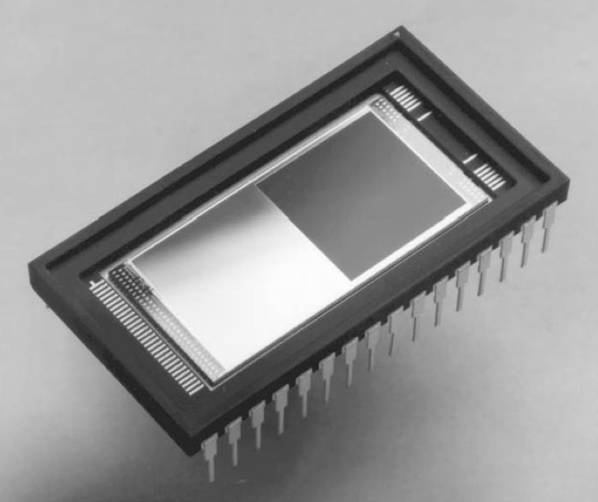
CCD
1024 px
FoV=
17’x17’
1024 px
E2V, CCD47-20 BACK THINNED AIMO
Plate scale: 1 px = 1 arcsec

Slide 4
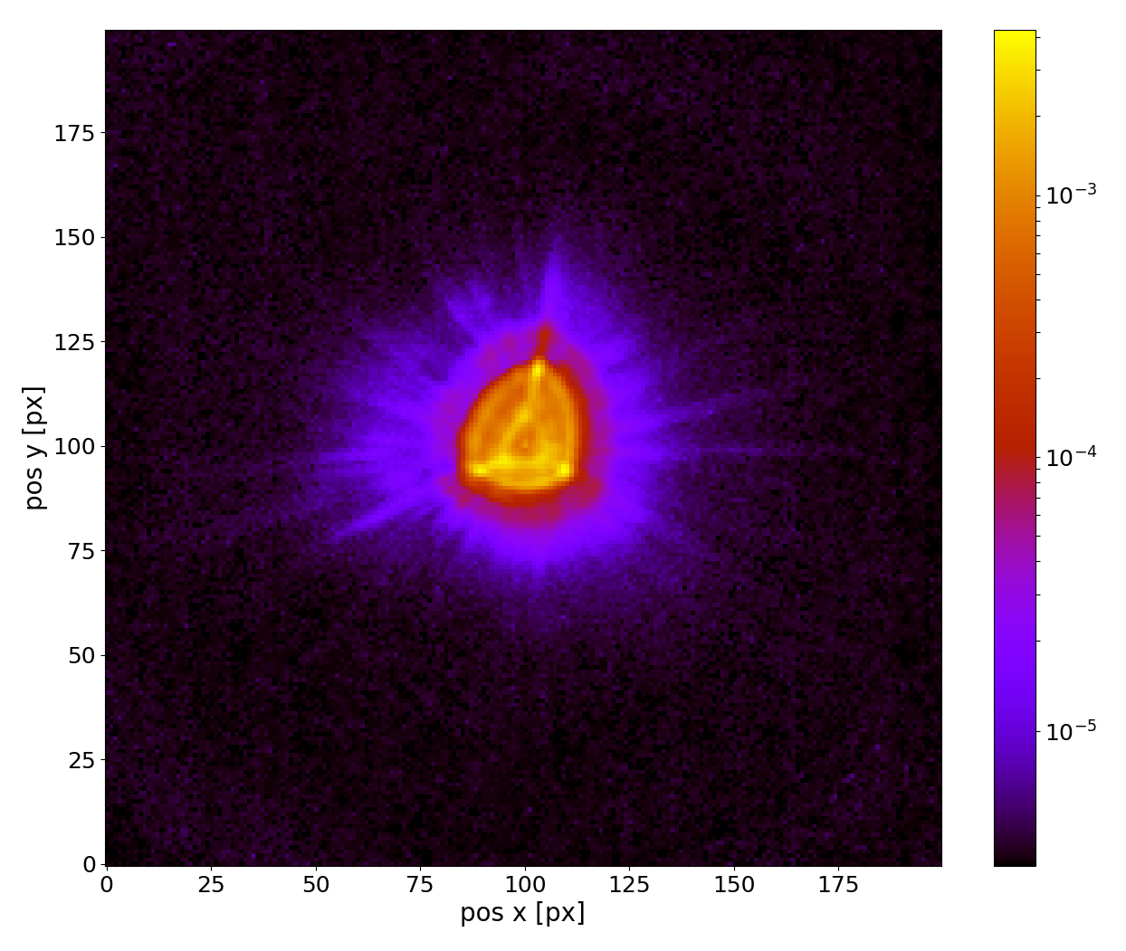
Point Spread Function
Defocus PSF
The radius of the PSF is ~16.5 px
Pros:
  each pixel is less susceptible to flux variations,
  bright stars are less likely to saturate
Cons:
  faint stars: the PSF large surface makes it more sensitive to the presence of hot/warm pixels and cosmic ray hits.
Notes:
CHEOPS has been purposely defocused: To improve photometric performances by mitigating the effect of pointing jitter,
avoiding saturation for bright targets, and to mitigate imperfect flat-field correction.
The size of the point-spread function (PSF),
that is the radius of the circle enclosing 90% of the energy received on the CCD
from the target star, has been estimated during the design phase to be within 12 px
to 15 px. The actual value as measured during in-orbit commissioning is 16 px (see
Section 11.1), a value reasonably close to the expected value.
The 10 highest peaks contain 3.5-4% of the total energy

Slide 5
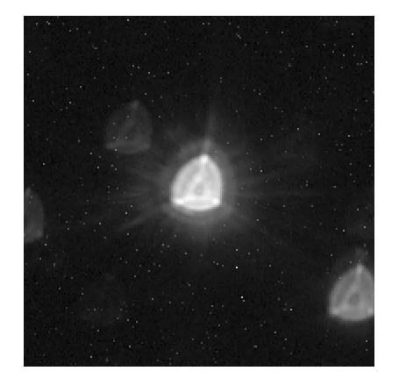
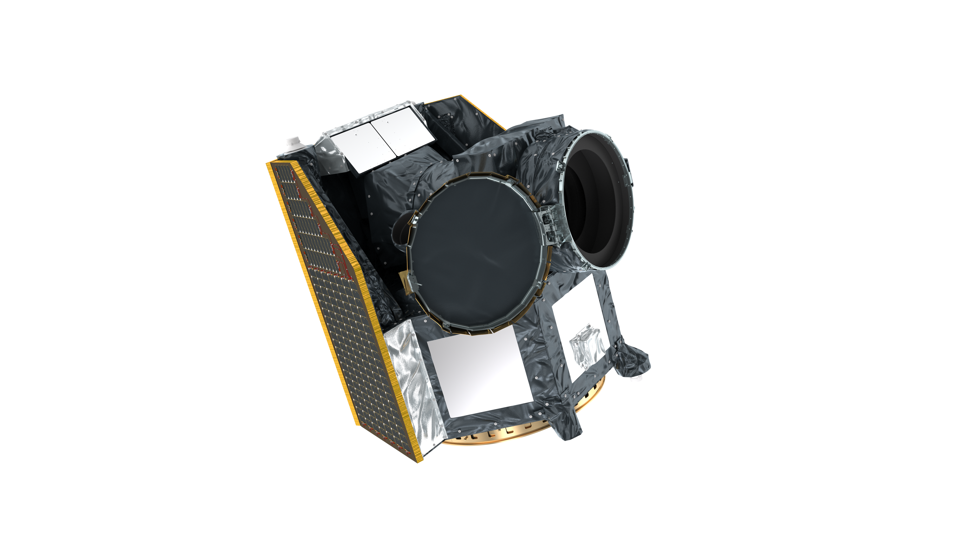
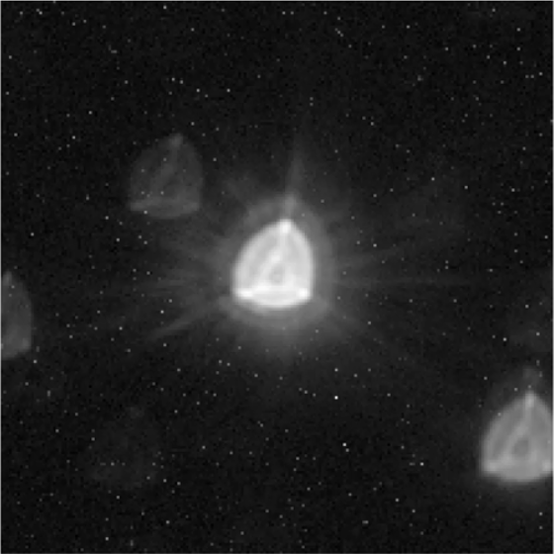
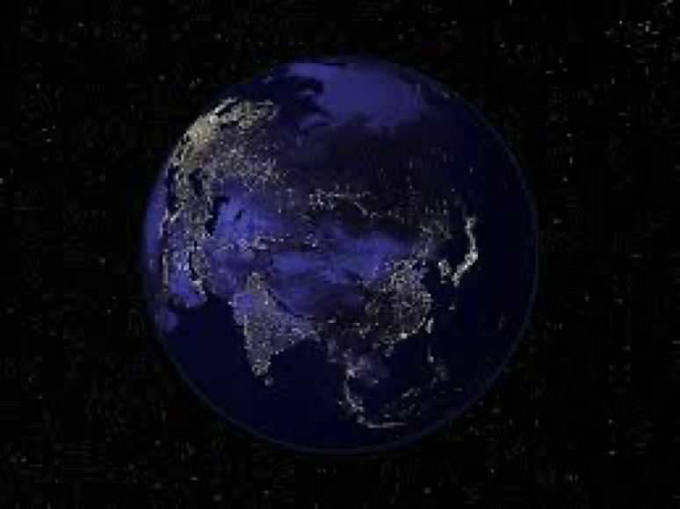
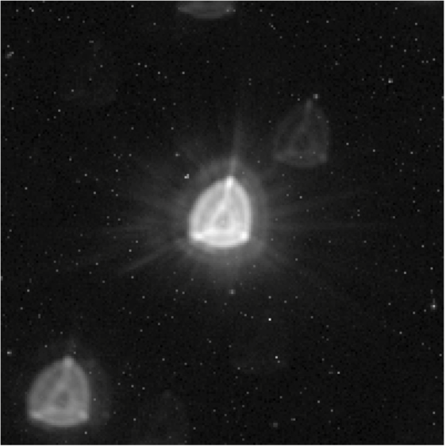
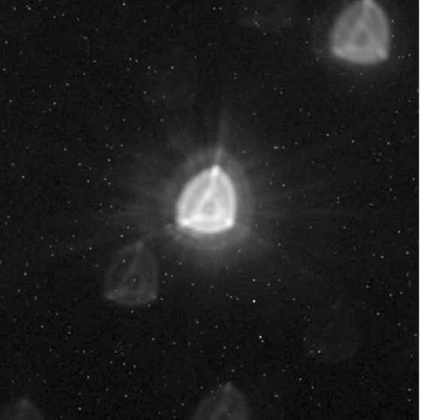
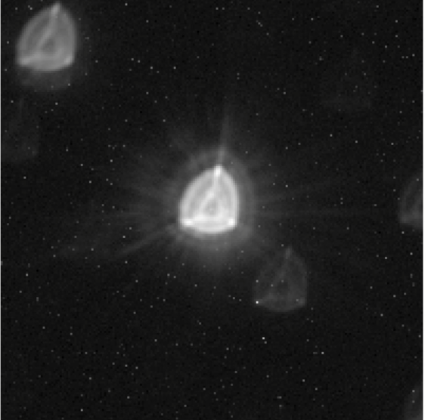
Images
Example of one orbit observation
Rotation of the stellar background
Pointing jitter
200x200 px window
Hot Pixels

Slide 6
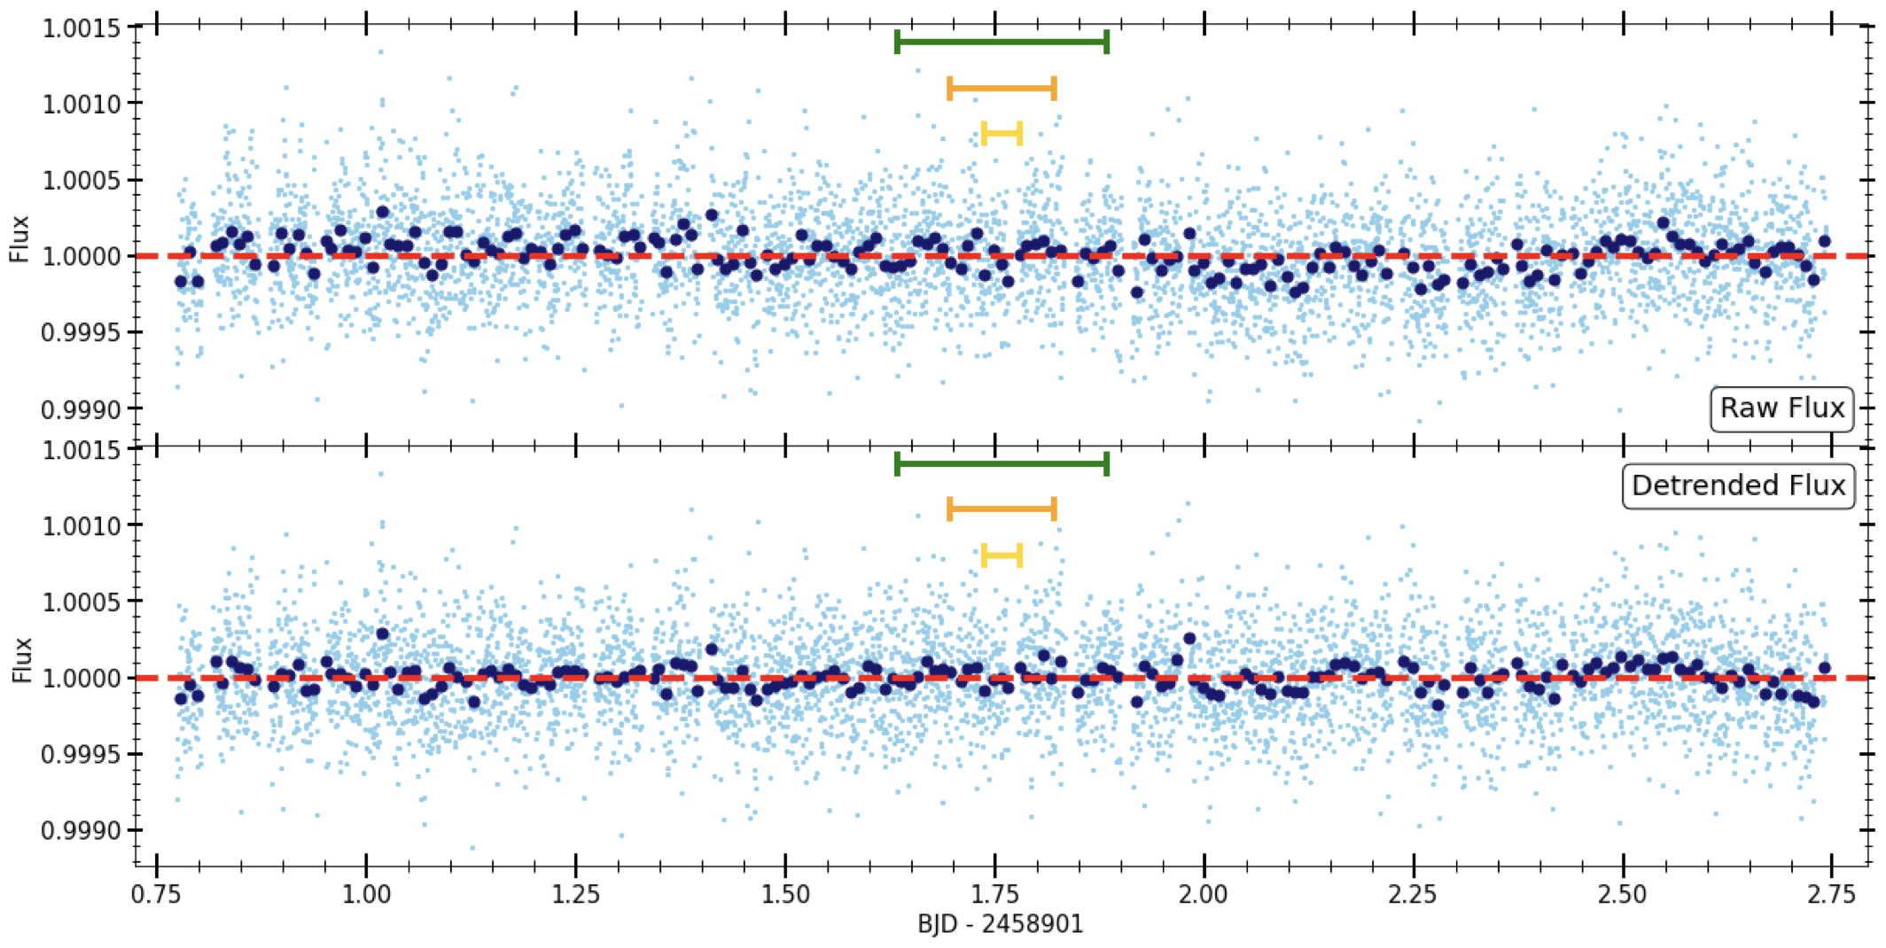
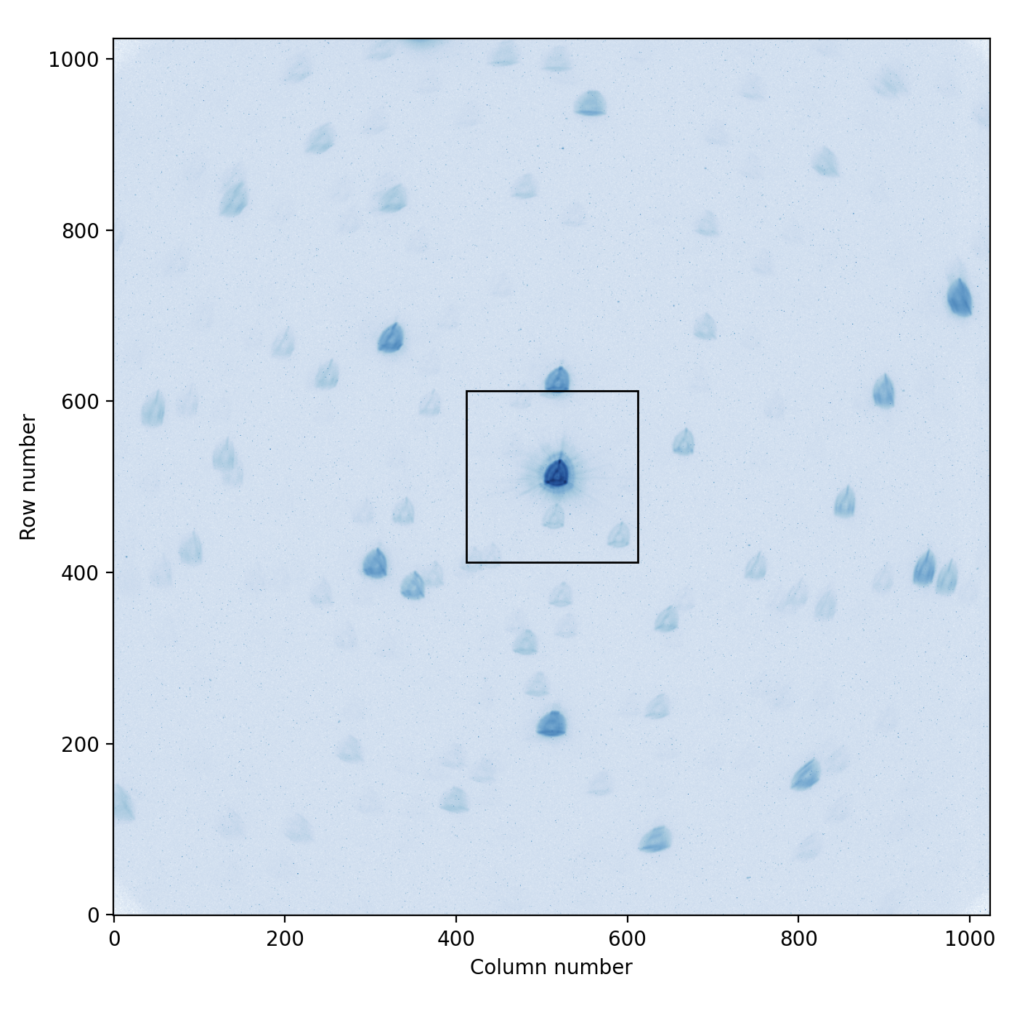
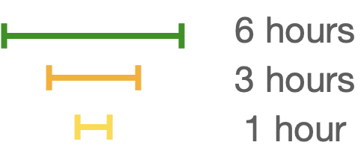
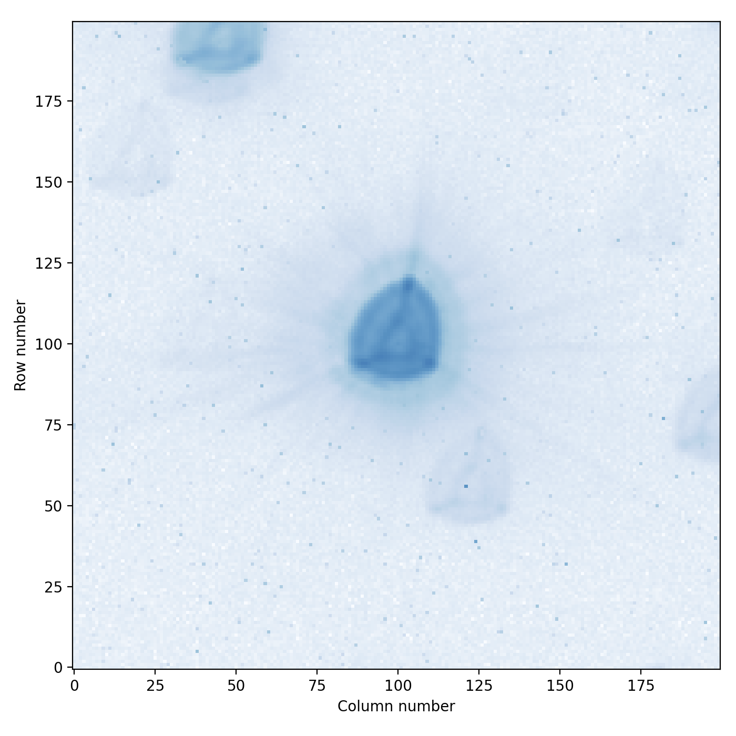
Lightcurves
HD88111
Exposure time: 30 s
Visit Duration: 47 h
Observation Date: 22/02/2020
G_{mag} = 8.97 (V = 9.2), Teff = 5330 K
Full Field of View
Window Image
Noise [ppm] | 1 min | 10 min | 30 min | 1 h | 3 h | 6 h
Raw LC | 202 | 75 | 45 | 31 | 18 | 12
Detrended LC | 193 | 62 | 36 | 27 | 15 | 11
ETC | 235 | 84 | 49 | 32 | 20 | 15
* See Benz et al. (2021) for more details. All data publicly available.
Notes:
The photometric precision and stability is estimated by finding the transit depth
that can be detected with a signal-to-noise ratio of 1. This is essentially the same
method used to calculate the Kepler combined differential photometric noise value

Slide 7
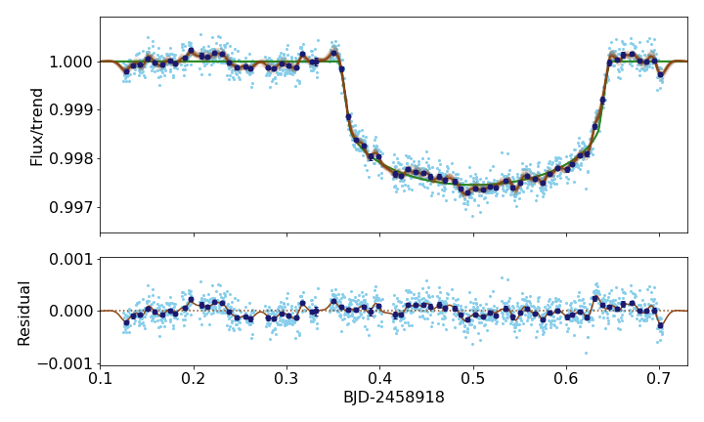
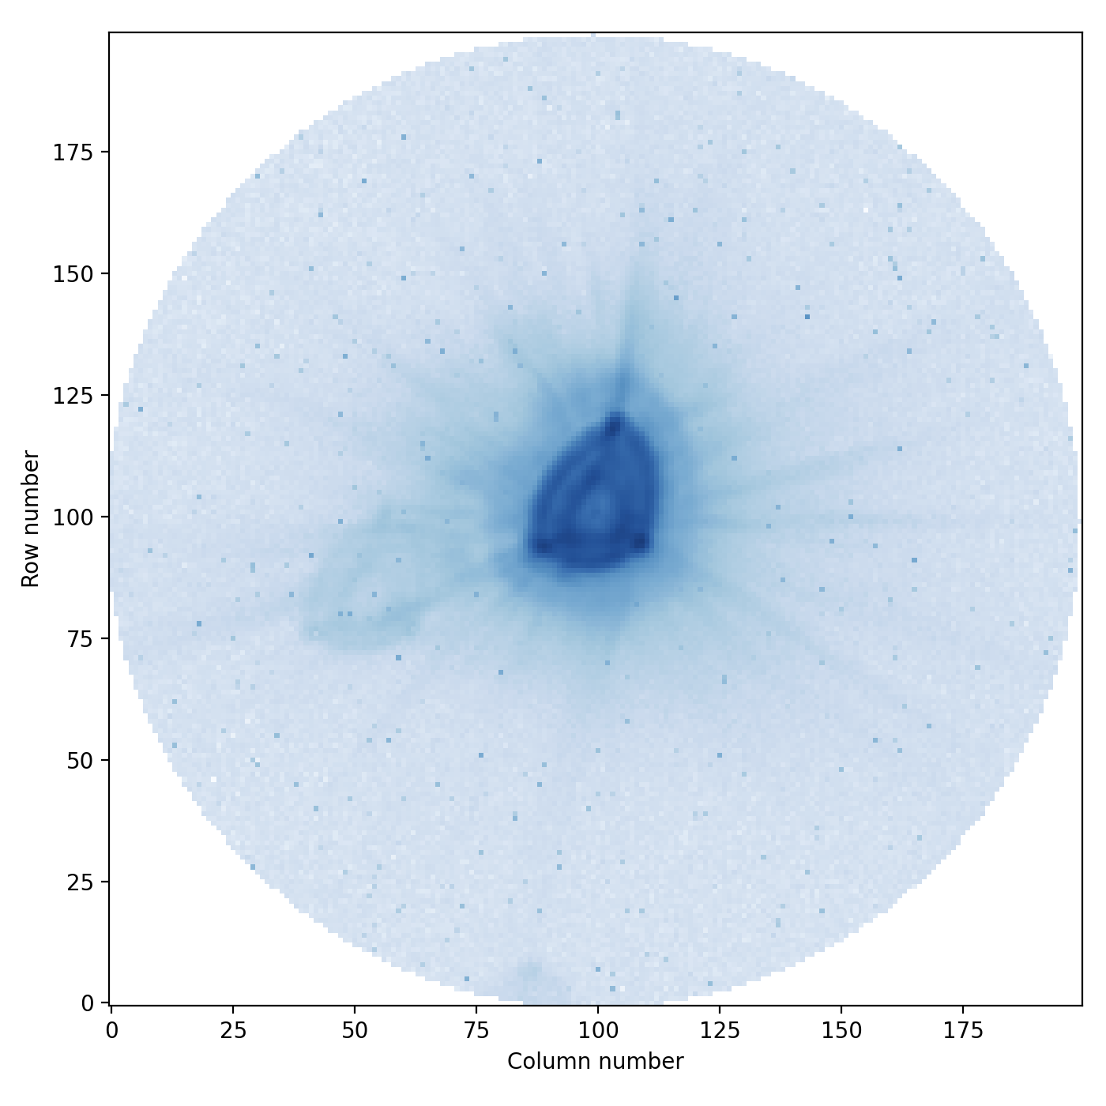



Lightcurves
Kelt-11b
Effective exposure time: 30 s
Visit Duration: 14 h
Observation Date: 09/03/2020
G_{mag} = 7.83 (V = 8), Teff = 5340 K
See Benz et al. (2021) for more details. All data publicly available.
Transit depth = 0.0021±0.0001
R_{P} = 1.295 ± 0.025 R_{J}
(R★ = 2.807 ± 0.036 R⨀)
The uncertainty of R_{p} is 5x smaller, mainly dominated by the uncertainty of R★
Notes:
KELT-11b (V = 8) was discovered by the KELT survey in 2016, the radius of the planet measured by transit photometry is Rp = 1.37 RJ (+- 0.15 RJ). Mass derived from RVs, 0.195 MJ. KELT-11b is a so-called bloated giant planet having about 20% of the mass of Jupiter but a radius larger by almost 40%. Radius measured by CHEOPS: Rpl = 1.295 +-0.025RJup. This value is consistent with the value obtained earlier but with an error bar 5 times smaller. Period = 4.7 days.
Rstar = 2.8 Rsun, Teff = 5340 , yellow subgiant, ST G9, Mass = 1.44 Msun
Binning: 10 minutes. Exposure time: 15s, stacking order 2

Slide 8
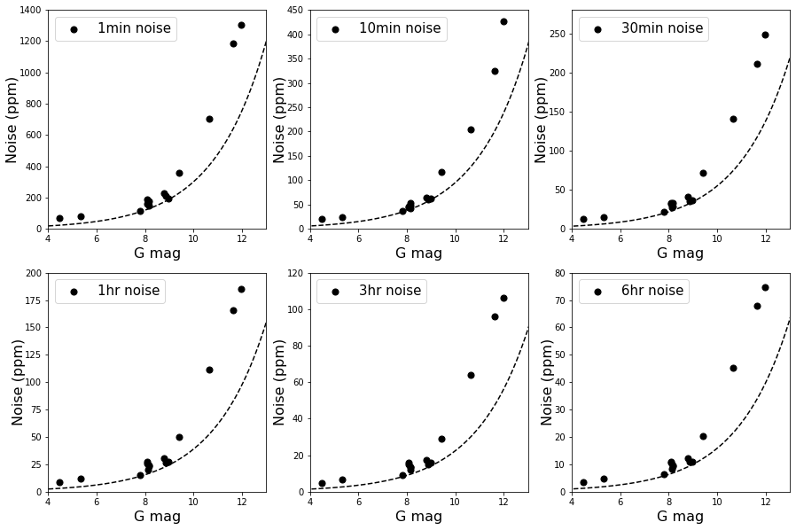
Measured photometric precision as a function of the stellar Gaia magnitude and integration time.
The dashed curve represents the photon noise. Results obtained with pycheops✦ for lightcurves extracted using the default photometric aperture of r = 25 px (DRPv13.1).
Photometric precision
✦ https://github.com/pmaxted/pycheops, P. Maxted (Maxted et al. 2021) DOI:10.1093/mnras/stab3371
“Analysis of Early Science observations with the CHaracterising ExOPlanets Satellite (CHEOPS) using pycheops”

Slide 9
Hot Pixels

Slide 10
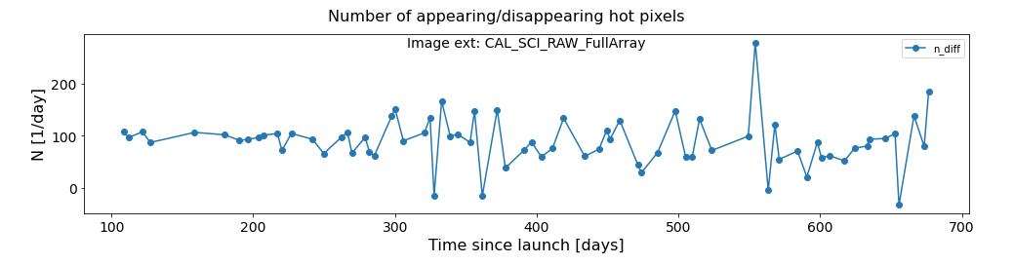
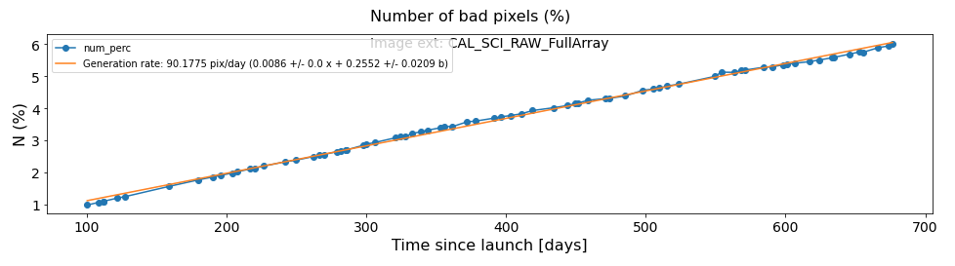
Hot Pixels
Hot pixels: pixels with dark current > 3 e-/s
For reference: mean dark current (w/o hot pixels) at beginning of life: 0.06 e-/s
Stable net generation rate of hot pixels: 100 per day
Linear increase of the number of hot pixels with time. Currently, 6% of the CCD pixels are hot pixels

Slide 11
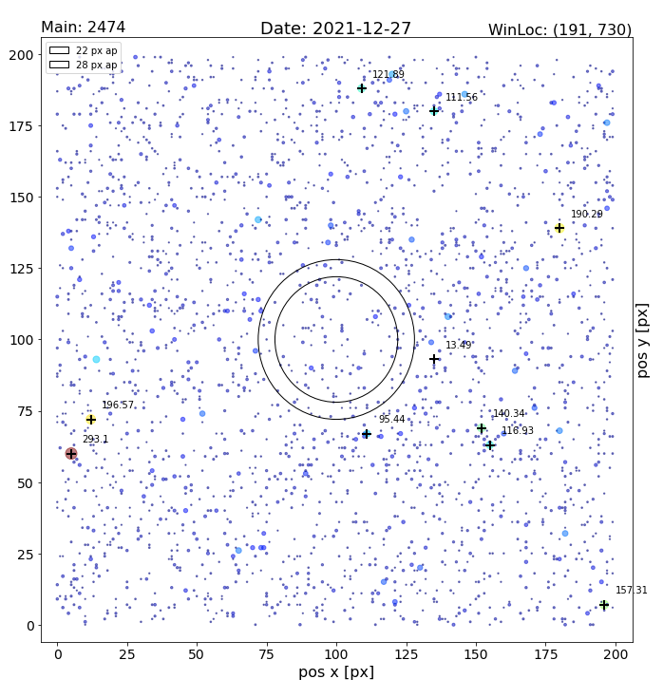
Hot Pixels: monitoring and characterisation

Slide 12
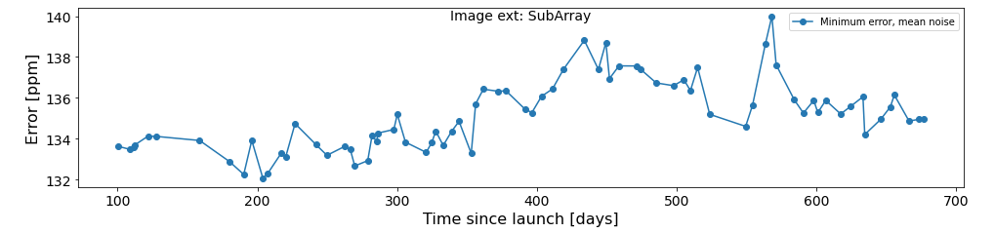
Hot Pixels: noise
Bright stars (G_{mag} ≲ 10) are insensitive to hot pixels
Faint stars (G_{mag} ≳ 10) show a sligthly degraded photometry with time (noise increse ~2% since launch)
Noise evolution in time due to the increase of hot pixels in the CCD. Noise values for the 3h bin, for a faint star (G mag~12). Results obtained combining simulations and real data.
Change in window location
Current mitigation strategy: place the target in the less noisy region of the CCD
Currently under study: correction of hot pixels in the Data Reduction Pipeline

Slide 13
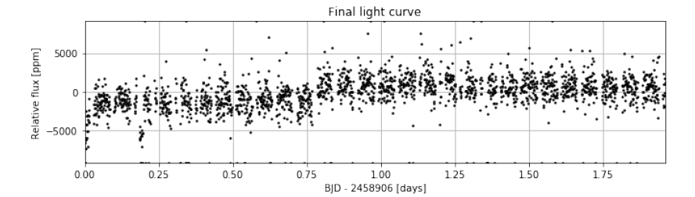

Hot Pixels: correlations in the light curve
It can happen that during a visit a hot pixel appears inside the aperture.
Jump in the LC due to the appearance of a hot pixel
We recommend to detect where the hot pixel is located in order to determine what is the best approach to correct for it.

Slide 14
Systematics in the light curves
Most of these systematics are corrected by the Data Reduction Pipeline (DRP, Hoyer et al. 2020) and pycheops (Maxted et al. 2021).
See
https://www.cosmos.esa.int/web/cheops/performances-photometric-precision
for further details.

Slide 15
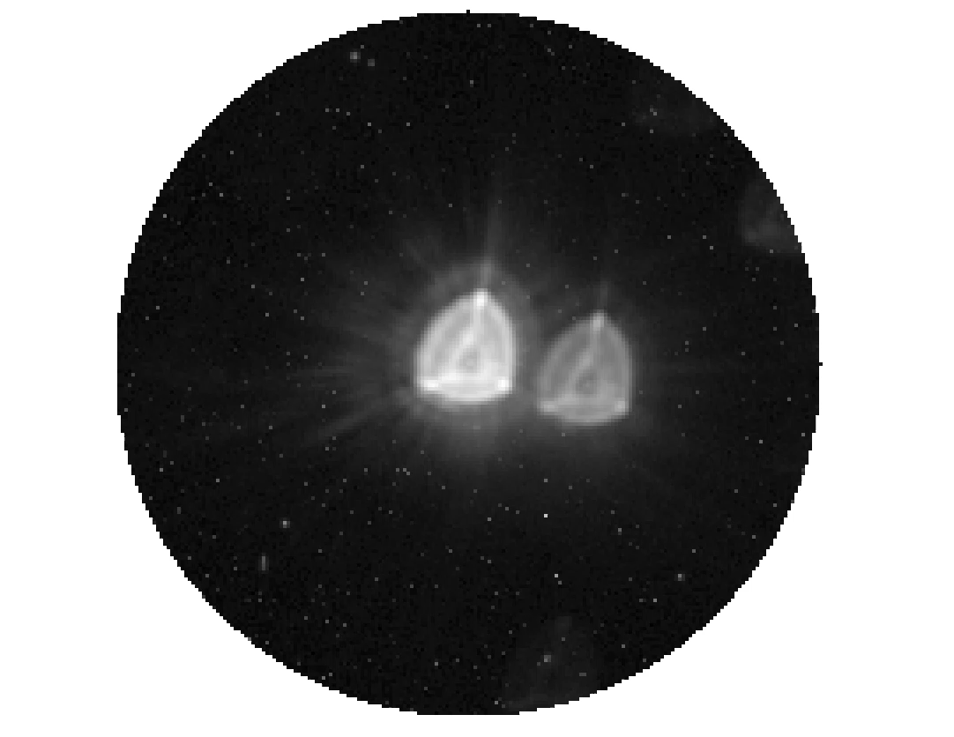
Correlations with the roll angle
Movie
Stars in the field of view:
Neighbouring stars rotate around the line of sight. Due to the large size and asymetrical shape of the PSF¹, background stars will contaminate with their flux the photometric aperture. Therefore, the measured flux will depend on the position of the satellite in the orbit: the photometric extraction will show a correlation with the roll angle. The background contamination is simulated by the DRP, which provides the background LC that can be used to correct the target’s LC. Pycheops can be used to improve the precision by decorrelating against roll angle.
¹PSF large size is reponsible for the contamination level, while PSF asymmetry is responsible of the roll dependency with the stars in the FoV.

Slide 16
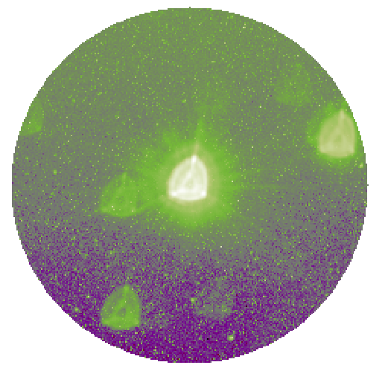
Correlations with the roll angle
Raw image
Earth stray-light
When the line of sight is close to the illuminated Earth limb, the background of the images can become very bright (and maybe also inhomogeneous). The image on the right represents a rather extreme example of this case. The stray light contamination follows the periodicity of the orbit during which it goes from ~0 to the maximum value (as in the figure on the bottom right).
The DRP performs homogeneous background correction. However, if there are gradients in the image, this correction will not eliminate them. Our recommendation is to exclude images with high background contamination or corresponding data points from the LC analysis.
Example of Earth SL variation in one orbit

Slide 17
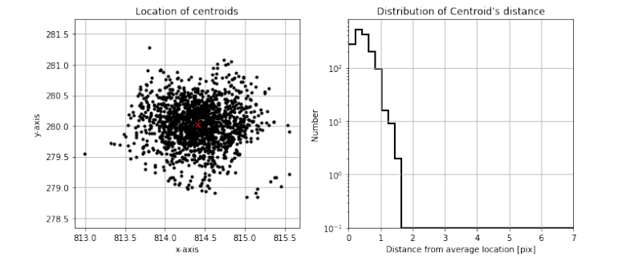
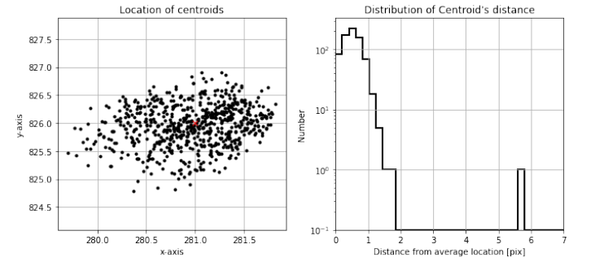
Correlations with pointing jitter
CHEOPS pointing is not stable within a pixel. It generally jitters around with an amplitude of 2-3 pixels depending on the pointing direction. A linear decorrelation against x and y will compensate for this. Such a decorrelation is available in pycheops.
CASE WITH PITL
CASE WITH NOPITL

Slide 18
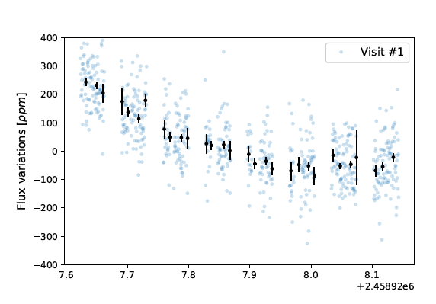
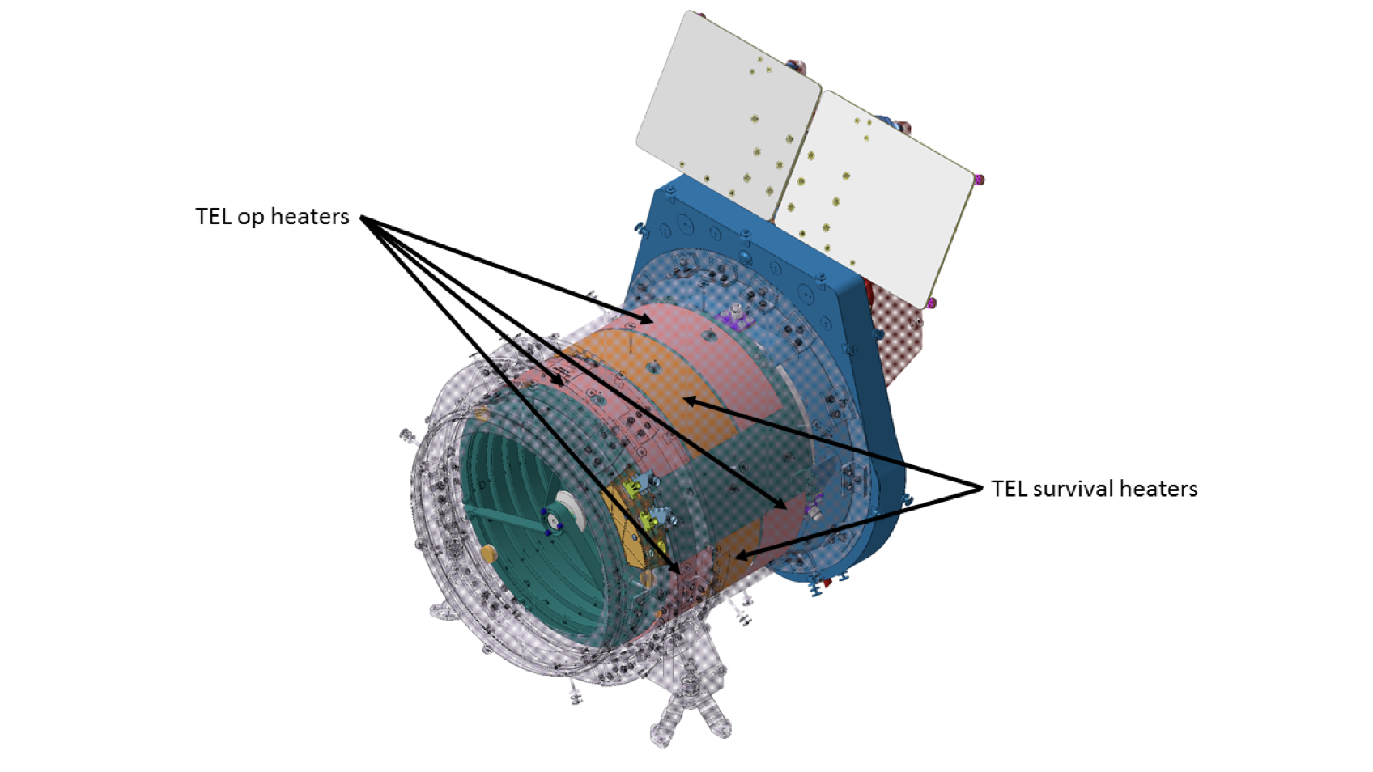
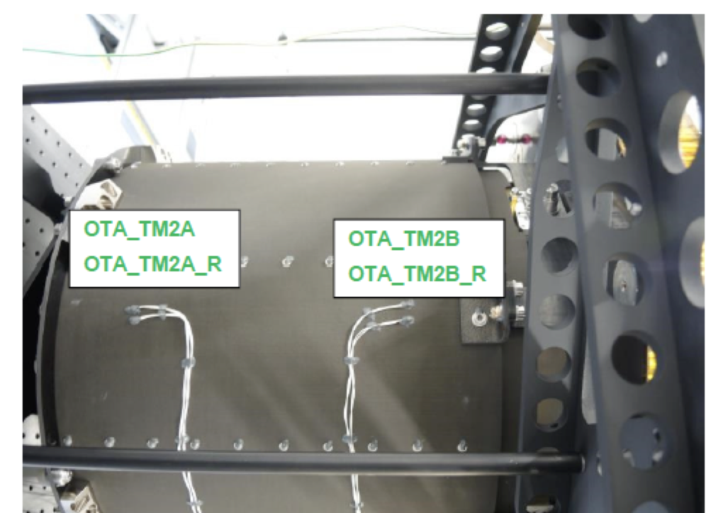
Correlations with the telescope tube temperature
Ramp effect
  If present, the ramp is always seen at the beginning of the visit
  The ramp is due to a “PSF breathing” which is connected to temperature changes in the telescope tube at the beginning of a new visit (due to the change in the poiting direction) ➙ note however that not all visits present a ramp!!!
  It’s hard to define a typical duration: between 2.5 and 12 hours
  Hint to detect the ramp: check the HK parameter thermFront_2

Slide 19
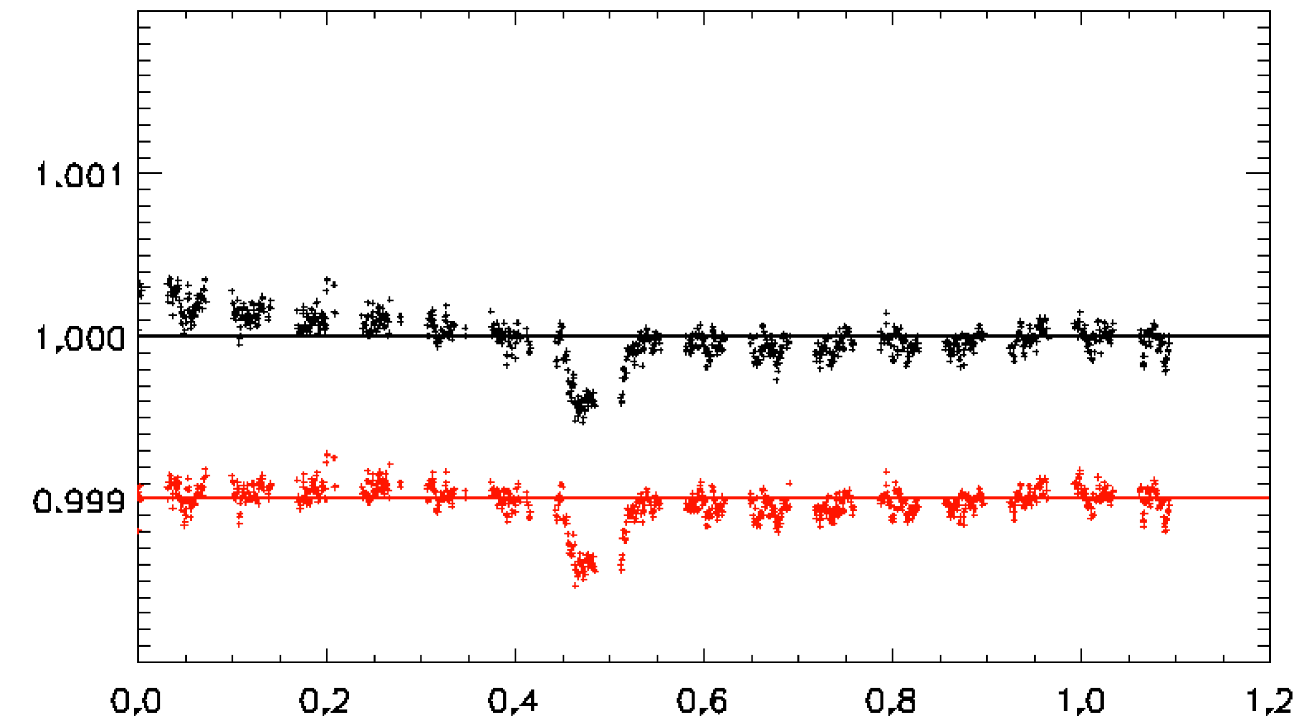
Correlations with the telescope tube temperature
Ramp effect
Two independent ways for correcting for the ramp have been proposed and seem to work very well:
Autocorrelation + Principal Components Analysis of the images (see Wilson et al., submitted to MNRAS)
Linear decorrelation. The linear decorrelation has been implemented in pycheops
Flux_{corrected} = Flux_{measured} (1+𝛃∆T)
∆T = T_{thermFront_2} + 12
𝛃 = constant that depends on the aperture size,
𝛃 = 0.0004 for R_{ap} = 40 px;
𝛃 = 0.00033 for R_{ap} = 30 px;
𝛃 = 0.0002 for R_{ap} = 25 px;
𝛃 = 0.00014 for R_{ap} = 22.5 px
LC with ramp
Corrected LC

Slide 20
Observing outside the nominal magnitude range

Slide 21
Observing outside the nominal magnitude range
CHEOPS was optimized to observe stars in the magnitude range 6 ≤ G_{mag} ≤ 12
Main limitations for observing fainter stars:
  background contamination (straylight, stars in the FoV)
  hot pixels
  cosmic rays
  Note that a 1-m ground-based telescope will perform photometrically better than CHEOPS for stars fainter than G_{mag}~13. Therefore, the reason to use CHEOPS in these cases should be well justified (e.g. long, uninterrupted observations needed).

Slide 22
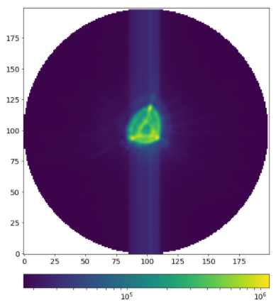
When observing very bright stars, consider …
CHEOPS is well suited for the observation of bright stars. However, when the stars are very bright CHEOPS performance is not optimal.
Short exposure times to avoid saturation: the observation of very bright stars require an exposure time well below 1 s. For example, a G_{mag} = 2.5 star would require a t_{exp} ~ 0.1 s. The read-out time is 1.25 s. Such short exposure times therefore translate into inefficient use of CHEOPS time.
Images of very bright stars show a strong self-smearing trail (see image on the right). Although the DRP can handle smearing trails within the nominal magnitude range, for very bright stars these are too strong and need a “personalized” treatment with a dedicated tool (not provided by the consortium).

Slide 23
Overview of Monitoring and Characterisation Programme
Mean dark current (excluding hot pixels) increased x5 since launch. Still negligible. Anyway accounted for in the background subtraction.
Bad pixels: no saturated pixel in the CCD, no bad columns or rows.
Monitor the potential change in time of the ramp decorrelation parameters. Based on statistical analysis of the nominal science visits. Still in a very preliminary stage.
Dark Current and Bad Pixels
Degradation in the Charge Transfer Efficiency (CTE) of the CCD is monitored using nominal science observations. The analysis so far indicates that, although measurable, the degradation is weaker than expected. Low impact in the photometric performance reported so far. If CTE starts to affect the precision, it can be accounted for in the analysis of the images.
Flux Ramp
Flux Sensitivity
Regular observations of reference stars to monitor potential instrumental changes in the measured flux.
Charge Transfer Efficiency
M&Cs
PSF
Regular observations of the same star in different locations of the CCD to monitor potential PSF variations.
Non-Linearity Correction
Stray Light
Regular observations of Moon straylight to monitor variations in the instrument rejection of spurious light. Successful for up to 30º off-axis angles. For larger angles, not possible to measure.
Objective: characterise the NLC for very low fluxes (< 100 ADU). Still on-going. Challenging.

Slide 24
Summary
CHEOPS photometric precision is excellent, in particular for bright stars (G_{mag}<10)
The number of hot pixels in the CCD linearly increases with time. This could eventually lead to a degradation in photometric precision for faint stars (G_{mag}>11) but not seen yet!
Instrument systematics are few and well characterised. Detrending is possible in most cases.
The M&C Programme runs smoothly and allows for early diagnosis of the instrument state

